Slide 1
Space X-falcon 9 Data Analysis
Narasimha Rao Vaddi

Slide 2
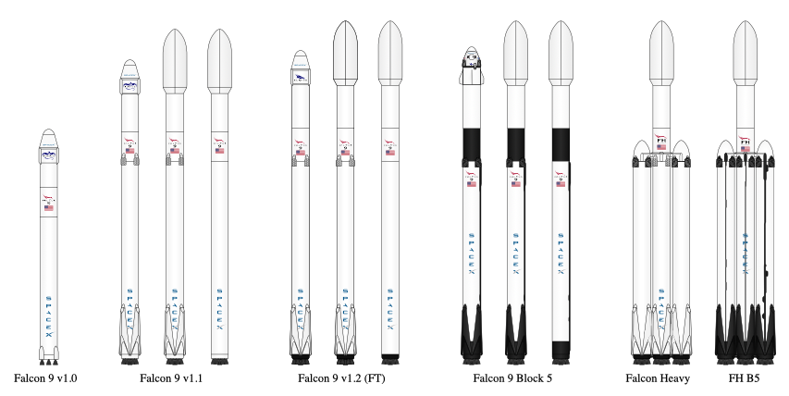
AGENDA
INTRODUCTION
Summary
Methodology
conclusion

Slide 3

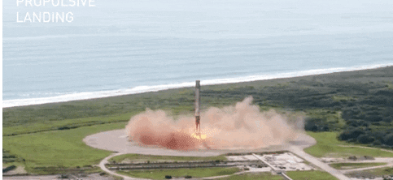
INTRO
SpaceX advertises Falcon 9 rocket launches on its website with a cost of 62 million dollars; other providers cost upward of 165 million dollars each, much of the savings is because SpaceX can reuse the first stage. Therefore if we can determine if the first stage will land, we can determine the cost of a launch. This information can be used if an alternate company wants to bid against SpaceX for a rocket launch. In this lab, you will collect and make sure the data is in the correct format from an API.
In this project, we will predict if Falcon-9 first stage will land successfully using data from Falcon-9 launch posted on the website.

Slide 4
Summary
methodologies
- Data Collection using SpaceX API
- Data Collection with Web Scraping
- Data Wrangling
- Exploratory Data Analysis using SQL
- EDA DataViz Using Python Pandas and Matplotlib
- Launch Sites Analysis with Folium-Interactive Visual Analytics and Ploty Dash
- Machine Learning Landing Prediction
• results
- EDA results
- Interactive Visual Analytics and Dashboards
- Predictive Analysis(Classification)

Slide 5

Methodology
Executive Summary
Data collection methodology:
Describes how data sets were collected
Perform data wrangling
Describes how data were processed
Perform exploratory data analysis (EDA) using visualization and SQL
Perform interactive visual analytics using Folium and Plotly Dash
Perform predictive analysis using classification models
How to build, tune, evaluate ML classification models

Slide 6
Data collection process
Data was collected using SpaceX restful API by making a get request to the SpaceX API.
to make the requested JSON results more consistent, the SpaceX launch data was
requested and parsed using the GET request and then converted into a Pandas data
frame.
performed web scraping to collect Falcon 9 historical launch records from a Wikipedia page titled List of Falcon 9 and Falcon launches records are stored in a HTML. Using BeautifulSoup and request Libraries, I extract the Falcon 9 launch HTML table records from the Wikipedia page, Parsed the table and converted it into a Pandas data frame

Slide 7
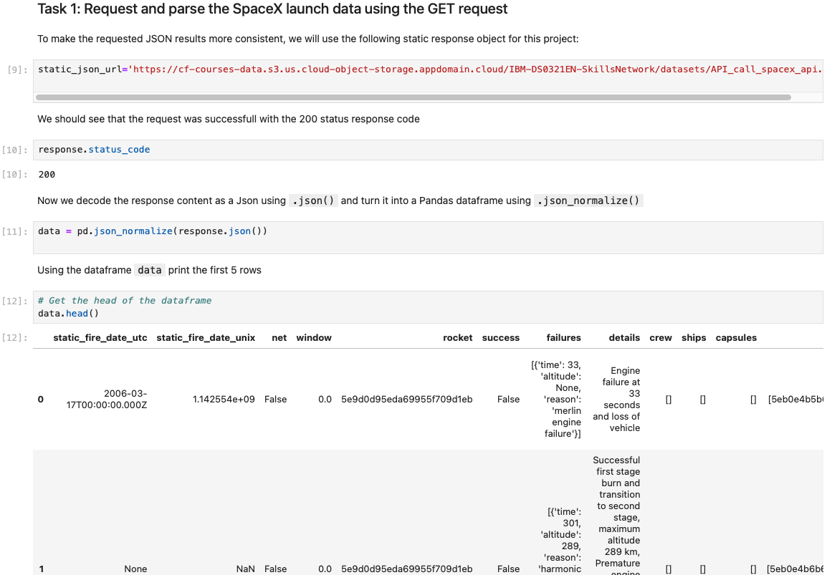
Data collection - Web API
Data collected using SpaceX API (a RESTful API) by making a get request to the SpaceX API then requested and parsed the SpaceX launch data using the GET request and decoded the response content as a Json result which was then converted into a Pandas data frame
Here is the GitHub URL of the completed SpaceX API calls notebook
(https://github.com/Nvaddi03/testrepo/blob/main/1.jupyter-labs-spacex-data-collection-api.ipynb)

Slide 8
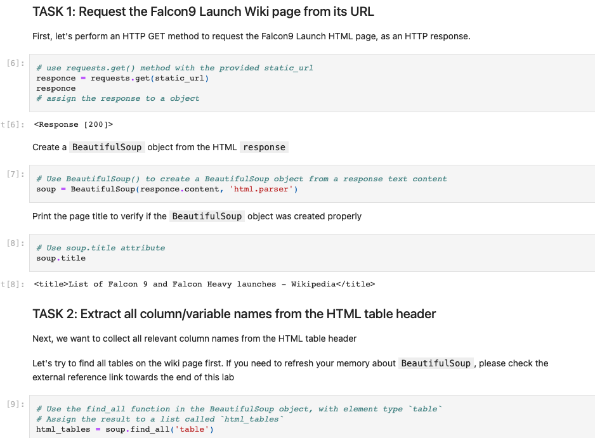
Data collection – Web scrapping
Performed web scraping to collect Falcon 9 historical launch records from a Wikipedia using BeautifulSoup and request, to extract the Falcon 9 launch records from HTML table of the Wikipedia page, then created a data frame by parsing the launch HTML.
Here is the GitHub URL of the completed web scraping notebook.
https://github.com/Nvaddi03/testrepo/blob/main/2.jupyter-labs-webscraping.ipynb

Slide 9
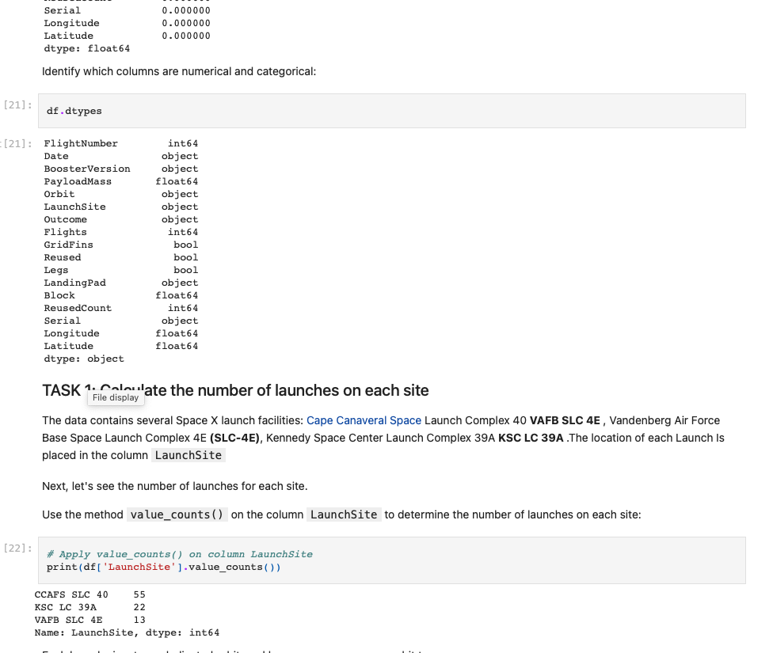
Data Wrangling
After obtaining and creating a Pandas DF from the collected data, data was filtered using the Booster Version column to only keep the Falcon 9 launches, then dealt with the missing data values in the Landing Pad and Payload Mass columns. For the Payload Mass, missing data values were replaced using mean value of column.
Also performed some Exploratory Data Analysis (EDA) to find some patterns in the data and determine what would be the label for training supervised models
https://github.com/Nvaddi03/testrepo/blob/main/3.jupyter-labs-spacex-Data%20wrangling.ipynb

Slide 10
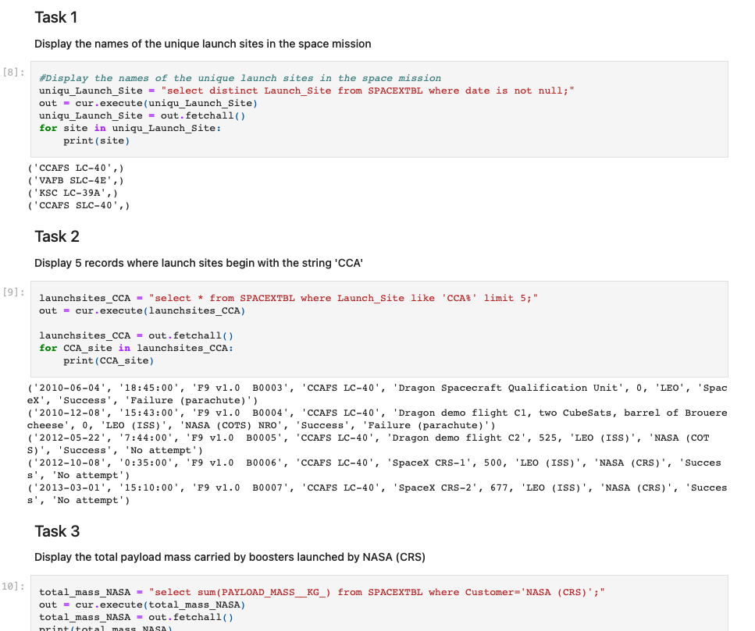
Data Visualization
Performed data Analysis and Feature Engineering using Pandas and Matplotlib.
• Exploratory Data Analysis
• Preparing Data Feature Engineering
Used scatter plots to Visualize the relationship between Flight Number and Launch Site, Payload and Launch Site, Flight Number and Orbit type, Payload and Orbit type.
Used Bar chart to Visualize the relationship between success rate of each orbit type
Line plot to Visualize the launch success yearly trend.
https://github.com/Nvaddi03/testrepo/blob/main/4.jupyter-labs-eda-sql-coursera_sqllite.ipynb

Slide 11
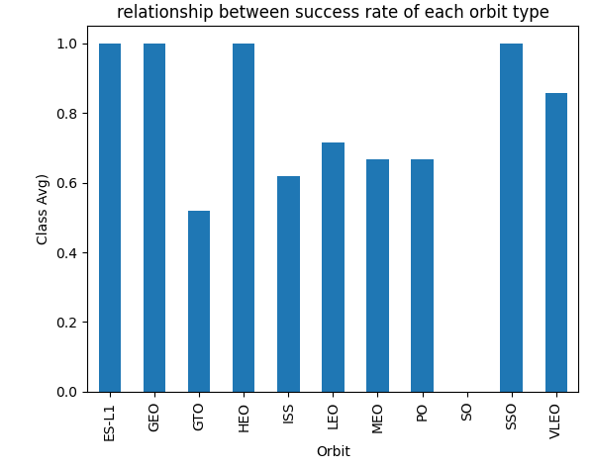
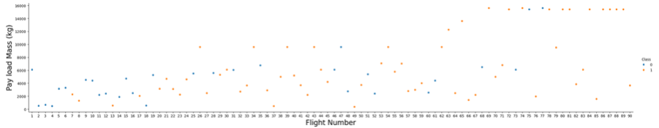
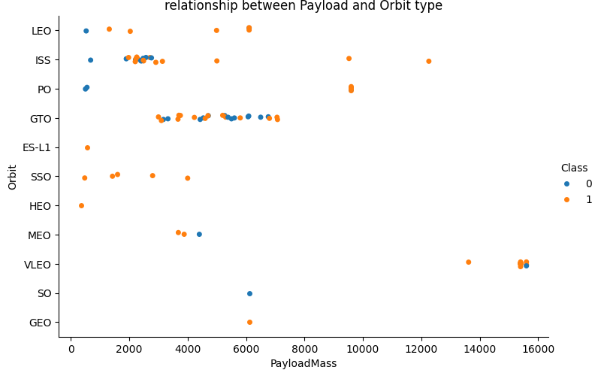
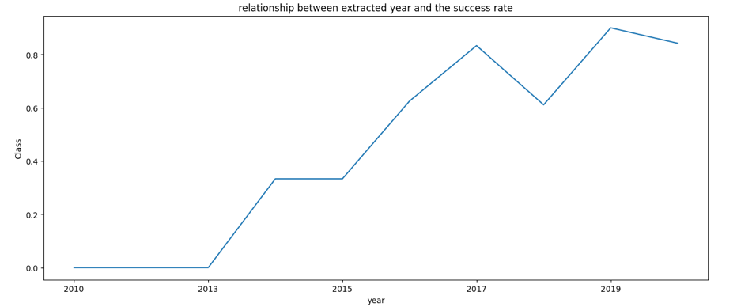
Data Visualization

Slide 12
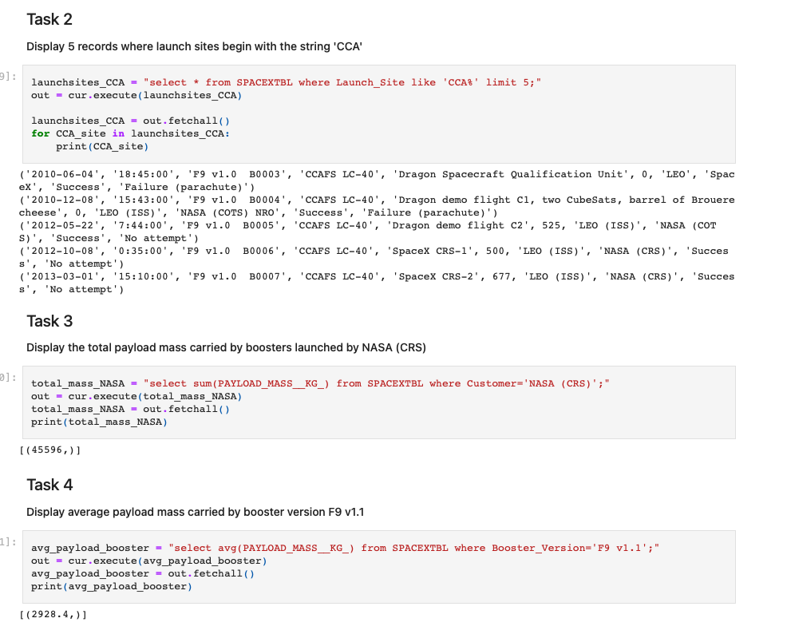
EDA With SQL
https://github.com/Nvaddi03/testrepo/blob/main/4.jupyter-labs-eda-sql-coursera_sqllite.ipynb

Slide 13
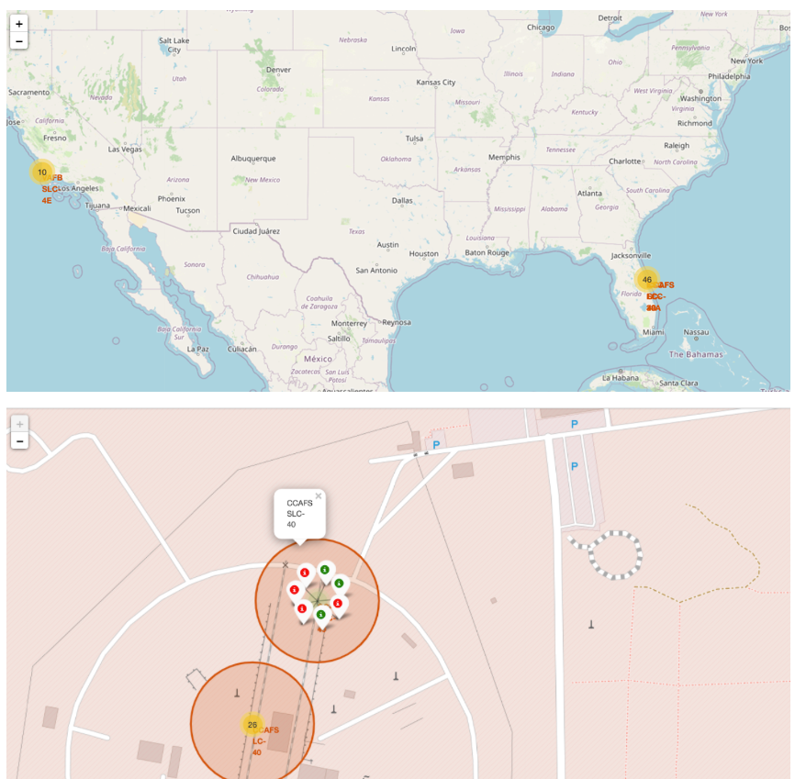
Interactive map with folium
Created folium map to marked all the launch sites, and created map objects such. as markers, circles, lines to mark the success or failure of launches for each launch site.
• Created a launch set outcomes (failure=0 or success=1).
https://github.com/Nvaddi03/testrepo/blob/main/6.lab_jupyter_launch_site_location.jupyterlite.ipynb

Slide 14
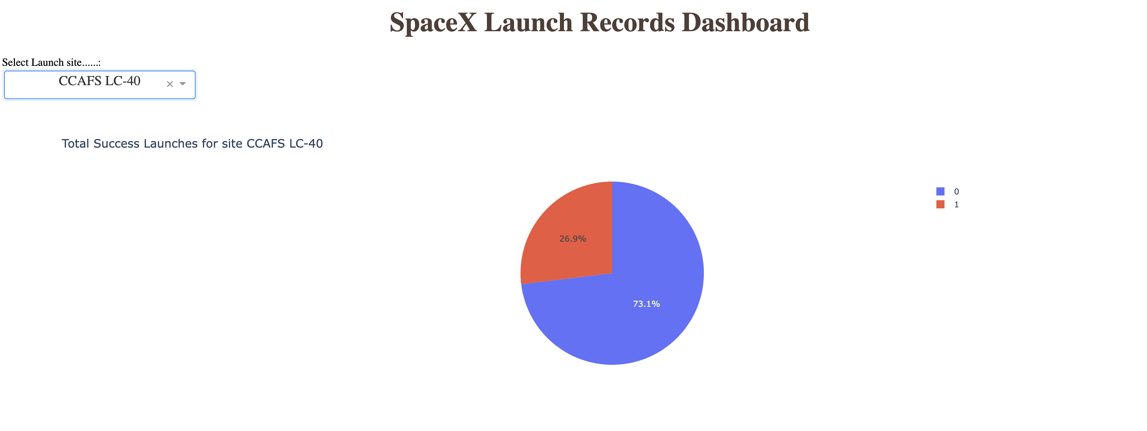
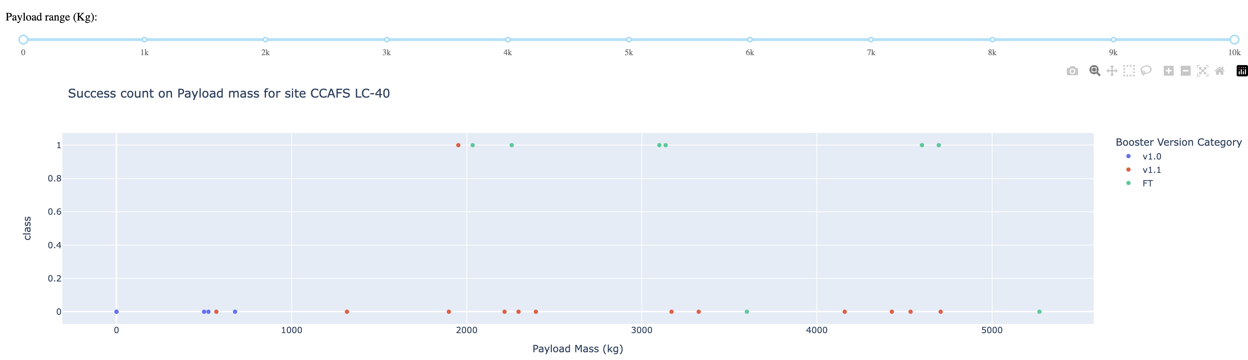
Build dashboard with plotly das
Built an interactive dashboard application with Plotly dash by:
• Adding a Launch Site Drop-down Input Component
• Adding a callback function to render success-pie-chart based on selected site dropdown
• Adding a Range Slider to Select Payload
• Addeng a callback function to render the success-payload-scatter- chart scatter plot
https://github.com/Nvaddi03/testrepo/blob/main/7.spacex_dash_app.py

Slide 15
Predictive Analysis
After loading the data as a Pandas Dataframe, I set out to perform exploratory Data Analysis and determine Training Labels by;
• creating a NumPy array from the column Class in data, by applying the method to_numpy() then assigned it to the variable Y as the outcome variable.
• Then standardized the feature dataset (x) by transforming it using preprocessing.StandardScaler() function from Sklearn.
• After which the data was split into training and testing sets using the
function train_test_split from sklearn.model_selection with the test_size parameter set to 0.2 and random_state to 2.
In order to find the best ML model/ method that would performs best using
the test data between SVM, Classification Trees, k nearest neighbors and
Logistic Regression;

Slide 16
Predictive Analysis
In order to find the best ML model/ method that would performs best using the test data between SVM, Classification Trees, k nearest neighbors and Logistic Regression;
First created an object for each of the algorithms then created a GridSearchCV object and assigned them a set of parameters for each model.
For each of the models under evaluation, the GridsearchCV object was created with cv=10, then fit the training data into the GridSearch object for each to Find best Hyperparameter.
After fitting the training set, we output GridSearchCV object for each of the models, then displayed the best parameters using the data attribute best_params_ and the accuracy on the validation data using the data attribute best_score_.
Finally using the method score to calculate the accuracy on the test data for each model and plotted a confussion matrix for each using the test and predicted outcomes
https://github.com/Nvaddi03/testrepo/blob/main/8.SpaceX_Machine_Learning_Prediction_Part_5.jupyterlite.ipynb

Slide 17
Conclusions
Different launch sites have different success rates. CCAFS LC-40, has a success rate of 60 %, while KSC LC-39A and VAFB SLC 4E has a success rate of 77%.
•We can deduce that, as the flight number increases in each of the 3 launcg sites, so does the success rate. For instance, the success rate for the VAFB SLC 4E launch site is 100% after the Flight number 50. Both KSC LC 39A and CCAFS SLC 40 have a 100% success rates after 80th flight
If you observe Payload Vs. Launch Site scatter point chart you will find for the VAFB-SLC launchsite there are no rockets launched for heavy payload mass(greater than 10000).
Orbits ES-L1, GEO, HEO & SSO have the highest success rates at 100%, with SO orbit having the lowest success rate at ~50%. Orbit SO has 0% success rate.
LEO orbit the Success appears related to the number of flights; on the other hand, there seems to be no relationship between flight number when in GTO orbit
The success rate is increased since 2013

Slide 18
THANK YOU
Narasimha Rao Vaddi

